Slide 1
Roadmap for DevOps @ DA
Nov 2019
Rahul Kamboj

Slide 2
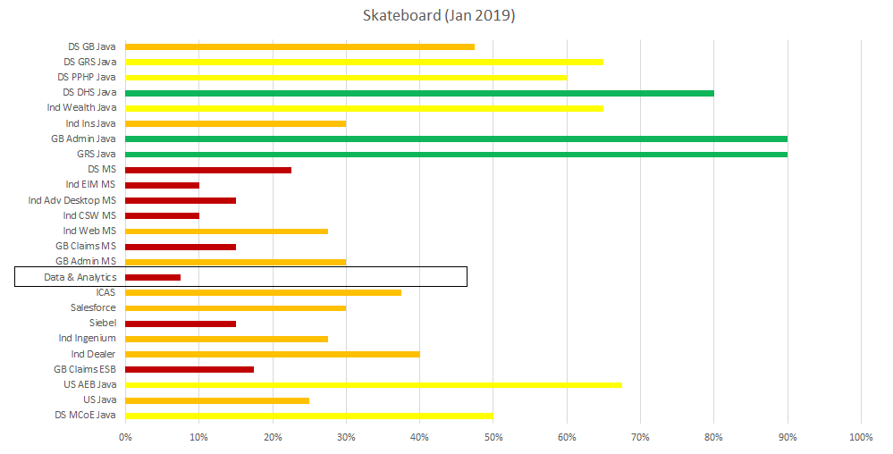
Current Challenges
Key Issues:
Manual build and deployment
Lack of Unit Test Automation
Lack of standard Code review / Feedback approach
Release management for the different environments
2
Notes:
Key Issues: Some automation, inconsistently applied, changes to process not in source control
Manual deployment:
Time intensive
Error prone
Lack of Unit Test Automation :
In many cases no unit test cases exists
Auto tests that do exist can be error prone, slow and conflict with others running tests
Lack of standard Code review approach
No insight into current application code state
No quick understanding of application size, vulnerabilities, maintainability
No feedback to developers of application problems until deployed into a “real” environment (often SIT/UAT)
Adhoc work item management and prioritization
No environment conflict or release management

Slide 3


Current State - DevOps Adoption (Before Q3 2019)
Code Review - Bitbucket branching / Manual
On Prem/AWS Server
Bitbucket Server (Code Management Repository)
1. Build Method
1. Manual review/approve code
(Code maintained on Bitbucket)
Build artifact on local machine
Local Machine
Deploy (Step 1)
Existing Application enhancement
2. Deploy Method
Build artifact on local machine
New Project Development
1. Get code
4. Commit
Manual copy artifacts on AWS or Lan Share from Bitbucket
2. Deploy Method
Deploy (Step 2)
2. Build
3. Develop
Manual build
IDE:
PyCharm (python)
Eclipse (java)
Manual copy artifacts on servers
Manual Verification
AWS Dev Env
AWS SIT
(UAT) Env
AWS Prod Env
Prod
Dev
SIT
(UAT)

Slide 4
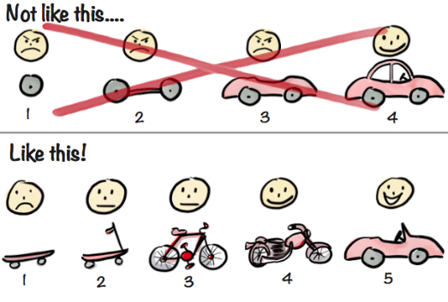
Roadmap MVP Approach
Skateboard
Auto build
Scooter
Code Quality and Analysis
Shift Left
Bicycle
Reduce Technical Debt
Motorcycle
Convertible Car
Auto Deploy
Containerization
Cloud Adoption
MVP: Skateboard
Primary Goal: Bitbucket Adoption (Branching and Merging strategies), Streamline Code Review Process, Auto Build, Code Analysis and Auto Deploy
Why?
Foundational. Provides a consistent, reliable, fast base for moving changes from development to production.
Key Benefits
Quick delivery of usable product
Immediate feedback
Eliminate manual deployment errors
Common dashboard showing technical debt levels
Centralized repository for dependencies (Artifactory)
Positions for license scanning
Positions for vulnerability scanning

Slide 5
Skateboard for BDCOE & IFRS
Step | Roadmap Stage | Subtask name | STATUS
 |  |  | BDCOE | IFRS
1 | Create DevOps adoption plan -Tools & Process
2 | Git and bitbucket Adoption ( repository creation, standardization, code placement, role and policies )
3 | Branching / Merging strategies
4 | Code Review Process
5 | Automated builds @ Jenkins | Jenkins Plugins Installation and configuration
 |  | Build Job Template creations on Jenkins | 80%
6 | Store Libraries in Artifactory | Update the build job template to add plugin for Artifatory
7 | Automated Deployment on On-Prem | Creation of Artifactory Release Job and Deployment Jobs | 50%
8 | Automated Deployment on AWS

Slide 6


















Proposed DevOps Roadmap
Bitbucket Server
MVP: Skateboard
Bitbucket (On Prem)
Trigger build from Develop branch Manually/AutoTrigger by web hook
5. Build (Job)
CI Server (On Prem)
PyBuilder
Onprem Alternative
(Server) – To Get Dependencies
Local Machine
(/GIT CLI / IDE plugins)`
Run Test cases on Build (Optional)
New Project Development
Get code
(Pull Code)
4. Approve
(generate PR)
(Push Code)
Processes needs to be defined
JIRA Workflow
Branching Strategy
Code Review Process
Test Driven Development
PYTest
(Server) – Publish Artifacts on Artifactory
3. Develop
6. Analyze (Parallel)
Sonar Server(On Prem)
2. Build
PyBuilder (Python)
IDE:
Warnings
(Server) Scheduled?
(Java)
(Scala & Java)
TODO scanner
(Scala & Java)
PyCharm
(Python)
(Scala & Java)
7. Deploy (Job)
Pipeline (Automated : Manual Trigger)
Test Local Deployment
(Optional)
Test Local Deployment
(Optional)
(Server) – Push deployment artifacts
Not In Scope for this phase
PYTest
(Python)
ScalaTest
(Scala)
Approve
(Java)
Pipeline (Automated Trigger)
Existing Application/ Enhancement
Copy Deployment files on S3 triggering from CodeDeploy
Intake & Work Management tracked with Kanban Board
AWS Dev Env
AWS UAT/SIT Env
AWS PROD Env

Slide 7
Appendix

Slide 8
DevOps Adoption Assessment as per Jan 2019

Slide 9
DevOps Adoption Assessment as per Jan 2019
GRS Java | Totals | % Complete |  | GB Admin Java | Totals | % Complete |  | GB Admin MS | Totals | % Complete |  | GB Claims MS | Totals | % Complete |  | GB Claims ESB | Totals | % Complete
Convertible | 0 | 0% |  | Skateboard | 36 | 90% |  | Skateboard | 12 | 30% |  | Skateboard | 6 | 15% |  | Skateboard | 7 | 18%
Motorcycle | 1 | 3% |  | Scooter | 3 | 8% |  | Scooter | 3 | 8% |  | Scooter | 8 | 20% |  | Scooter | 7 | 18%
Bicycle | 17 | 43% |  | Bicycle | 0 | 0% |  | Bicycle | 1 | 3% |  | Bicycle | 4 | 10% |  | Bicycle | 3 | 8%
Scooter | 20 | 50% |  | Motorcycle | 0 | 0% |  | Motorcycle | 0 | 0% |  | Motorcycle | 0 | 0% |  | Motorcycle | 0 | 0%
Skateboard | 36 | 90% |  | Convertible | 0 | 0% |  | Convertible | 0 | 0% |  | Convertible | 0 | 0% |  | Convertible | 0 | 0%
Ind Ins Java | Totals | % Complete |  | Ind Wealth Java | Totals | % Complete |  | Ind Web MS | Totals | % Complete |  | Ind CSW MS | Totals | % Complete |  | Ind Adv Desktop MS | Totals | % Complete
Skateboard | 12 | 30% |  | Skateboard | 26 | 65% |  | Skateboard | 11 | 28% |  | Skateboard | 4 | 10% |  | Skateboard | 6 | 15%
Scooter | 9 | 23% |  | Scooter | 13 | 33% |  | Scooter | 5 | 13% |  | Scooter | 0 | 0% |  | Scooter | 0 | 0%
Bicycle | 1 | 3% |  | Bicycle | 2 | 5% |  | Bicycle | 5 | 13% |  | Bicycle | 0 | 0% |  | Bicycle | 0 | 0%
Motorcycle | 0 | 0% |  | Motorcycle | 0 | 0% |  | Motorcycle | 0 | 0% |  | Motorcycle | 0 | 0% |  | Motorcycle | 0 | 0%
Convertible | 0 | 0% |  | Convertible | 0 | 0% |  | Convertible | 0 | 0% |  | Convertible | 0 | 0% |  | Convertible | 0 | 0%
Ind Agile Doc & Alert Cntr MS | Totals | % Complete |  | Ind EIM MS | Totals | % Complete |  | Ind Dealer | Totals | % Complete |  | Ind Ingenium | Totals | % Complete |  | Siebel | Totals | % Complete
Skateboard | 31 | 78% |  | Skateboard | 4 | 10% |  | Skateboard | 16 | 40% |  | Skateboard | 11 | 28% |  | Skateboard | 6 | 15%
Scooter | 14 | 35% |  | Scooter | 2 | 5% |  | Scooter | 6 | 15% |  | Scooter | 2 | 5% |  | Scooter | 6 | 15%
Bicycle | 24 | 60% |  | Bicycle | 0 | 0% |  | Bicycle | 10 | 25% |  | Bicycle | 0 | 0% |  | Bicycle | 0 | 0%
Motorcycle | 0 | 0% |  | Motorcycle | 0 | 0% |  | Motorcycle | 0 | 0% |  | Motorcycle | 0 | 0% |  | Motorcycle | 0 | 0%
Convertible | 0 | 0% |  | Convertible | 0 | 0% |  | Convertible | 0 | 0% |  | Convertible | 0 | 0% |  | Convertible | 0 | 0%
Salesforce | Totals | % Complete |  | ICAS | Totals | % Complete |  | Data & Analytics | Totals | % Complete |  | US Java | Totals | % Complete |  | US AEB Java | Totals | % Complete
Skateboard | 12 | 30% |  | Skateboard | 15 | 38% |  | Skateboard | 3 | 8% |  | Skateboard | 10 | 25% |  | Skateboard | 27 | 68%
Scooter | 19 | 48% |  | Scooter | 3 | 8% |  | Scooter | 1 | 3% |  | Scooter | 9 | 23% |  | Scooter | 8 | 20%
Bicycle | 8 | 20% |  | Bicycle | 12 | 30% |  | Bicycle | 2 | 5% |  | Bicycle | 10 | 25% |  | Bicycle | 24 | 60%
Motorcycle | 40 | 100% |  | Motorcycle | 0 | 0% |  | Motorcycle | 0 | 0% |  | Motorcycle | 0 | 0% |  | Motorcycle | 0 | 0%
Convertible | 40 | 100% |  | Convertible | 0 | 0% |  | Convertible | 8 | 20% |  | Convertible | 4 | 10% |  | Convertible | 0 | 0%
DS MS | Totals | % Complete |  | DS DHS Java | Totals | % Complete |  | DS PPHP Java | Totals | % Complete |  | DS GRS Java | Totals | % Complete |  | DS GB Java | Totals | % Complete
Skateboard | 9 | 23% |  | Skateboard | 32 | 80% |  | Skateboard | 24 | 60% |  | Skateboard | 26 | 65% |  | Skateboard | 19 | 48%
Scooter | 2 | 5% |  | Scooter | 12 | 30% |  | Scooter | 6 | 15% |  | Scooter | 10 | 25% |  | Scooter | 2 | 5%
Bicycle | 4 | 10% |  | Bicycle | 1 | 3% |  | Bicycle | 0 | 0% |  | Bicycle | 6 | 15% |  | Bicycle | 1 | 3%
Motorcycle | 0 | 0% |  | Motorcycle | 0 | 0% |  | Motorcycle | 0 | 0% |  | Motorcycle | 0 | 0% |  | Motorcycle | 0 | 0%
Convertible | 0 | 0% |  | Convertible | 0 | 0% |  | Convertible | 0 | 0% |  | Convertible | 0 | 0% |  | Convertible | 0 | 0%
DS MCoE Java | Totals | % Complete |  | Ind Agile Doc & Alert Cntr Java | Totals | % Complete
Skateboard | 20 | 50% |  | Skateboard | 32 | 80%
Scooter | 8 | 20% |  | Scooter | 24 | 60%
Bicycle | 6 | 15% |  | Bicycle | 23 | 58%
Motorcycle | 0 | 0% |  | Motorcycle | 0 | 0%
Convertible | 0 | 0% |  | Convertible | 0 | 0%

Slide 10
JD for the new Position
Sr Developer DevOps/BigData /AWS Cloud (5 to 7 years)
Skills Required:-
Working experience and good understanding of the AWS environment, including EC2, EBS, S3,EMR, Glue, CodeDeply, Pipeline
Good Experience using CI/CD tools like Bitbucket, Jenkins, JIRA, Ansible/Docker, CDD to accomplish infrastructure automation
Some hands on experience with building and running cloud - based solutions for Amazon Web Services
A strong command of software-automation and deployment systems
Comfortable writing complex scripts/services that pull and manipulate data from heterogeneous data sources, databases, Hadoop, flat files, etc.
Good knowledge of object oriented analysis, design, and programming in Scala or Python
Experience in performing ETL and data manipulation using Python and Sql. Coding experience in Python.
Experience in BIG Data using HDFS --- Must Have experience on SPARK framework development
Ability to work within a team environment as well as independently
Qualifications:
Bachelors Degree in Computer Science or related fields
3+ years of relevant experience in DevOps implementation on On-prem and AWS Cloud
Familiarity with Big Data tech such as Hadoop and Spark

